Slide 1

A Novel Hybrid Deep Learning Architecture for
Dynamic Hand Gesture Recognition
By DAVID RICHARD TOM HAX , PASCAL PENAVA , SAMIRA KRODEL , LILIYA RAZOVA , AND RICARDO BUETTNER
By Manvith Reddy Kundavaram

Slide 2

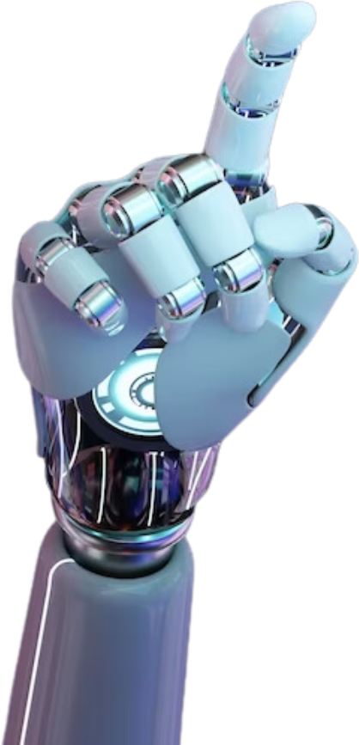
Motivation
01
Human-Computer Interaction (HCI) is becoming increasingly important as computers are integrated into our daily lives.
Natural and accessible HCI methods, such as gesture-based communication, are needed.
Hand gestures are a natural and intuitive way for humans to convey messages and interact with their environment.
Vision-based gesture recognition offers a convenient and natural way for users to interact with computers without specialized equipment.
This can be applied in various fields like smart home devices, gaming, education, and more.

Slide 3
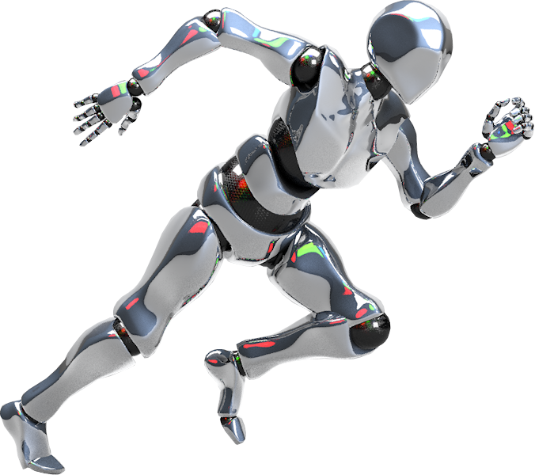
02
Problem Statement
Current machine learning models struggle to achieve high accuracy in recognizing hand gestures in realistic environments.
Real-life environments present challenges like varying lighting, complex backgrounds, and the presence of other objects or people.
There is a need for a robust hand gesture recognition system that can accurately classify gestures in realistic, unconstrained settings.
Most previous research has focused on gestures in controlled environments or with a clear focus on the hands.

Slide 4
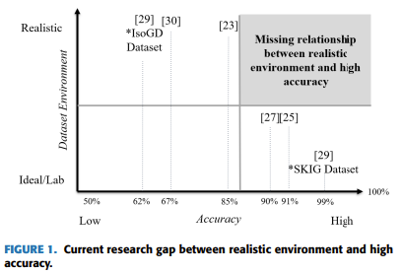
02
Problem Statement

Slide 5
03
Objectives
Develop a novel hybrid deep learning architecture for dynamic hand gesture recognition.
Achieve high accuracy in classifying hand gestures recorded in realistic environments.
Narrow the disparity between realistic environments and high accuracy in gesture recognition.
Create a system suitable for real-world use, where users can interact with machines through gestures in their natural environment.
This involves addressing challenges like real-time data transmission, recognizing unusual gestures, and handling complex backgrounds.

Slide 6
Contributions
04
A novel hybrid deep learning architecture combining a recurrent neural network (RNN) with a convolutional neural network (CNN).
Achieved an average accuracy of 83.66% in classifying a new comprehensive dataset on hand gesture recognition.
The proposed architecture enables a system suitable for real-world use, where users can be in realistic environments without external equipment.
The system does not require focusing on hands for gesture recognition and can handle unintentional gestures and subject motion.
This architecture is computationally effective and capable of classifying gestures in real time.

Slide 7
Results
05
The proposed model successfully classifies hand gestures with an average accuracy of 83.66%.
The model demonstrates robustness against complex backgrounds and variations in lighting conditions.
The hybrid architecture effectively captures both spatial and temporal features of hand gestures.
The system achieves real-time performance, making it suitable for practical applications.
The model was trained and evaluated on the Depth_Camera_Dataset, which includes 6 different gestures performed by various individuals.

Slide 8
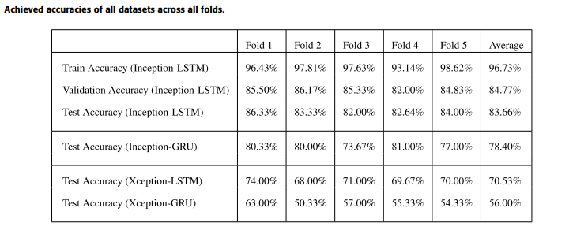
Results
05
By applying k-fold cross-validation with 5 stratified folds we achieved the averaged accuracies of 96.73%, 84.77%, and 83.66% for the train-, validation-, and test-sets.

Slide 9


Critical Analysis
06
The model's accuracy is slightly lower than the benchmark for similar tasks, indicating room for improvement.
The most misclassifications occur between similar gestures (e.g., scroll-right vs. scroll-up, zoom-in vs. zoom-out).
The model may struggle with gestures performed from significantly different angles or with multiple people gesturing simultaneously.
Future work can explore techniques to address these limitations and further improve the model's accuracy and robustness.
Potential improvements include dynamic learning rate adaptation, exploring different optimizers, and addressing micro-movements before and after gestures.

Slide 10
07
References
G. R. S. Murthy and R. S. Jadon, ‘‘Hand gesture recognition using neural networks,’’ in Proc. IEEE 2nd Int. Advance Comput. Conf. (IACC), Patiala, India: IEEE, Feb. 2010, pp. 134–138. [Online]. Available: http://ieeexplore.ieee.org/document/5423024/
R. P. Sharma and G. K. Verma, ‘‘Human computer interaction using hand gesture,’’ Proc. Comput. Sci., vol. 54, pp. 721–727, 2015. [Online]. Available: https://linkinghub.elsevier.com/retrieve/pii/S187705091501409X
P.-J. Gonzalo and A. H.-T. Juan, ‘‘Control of home devices based on hand gestures,’’ in Proc. IEEE 5th Int. Conf. Consum. Electron. Berlin (ICCE-Berlin). Berlin, Germany: IEEE, Sep. 2015, pp. 510–514. [Online]. Available: http://ieeexplore.ieee.org/document/7391325/
Y. Zhu and B. Yuan, ‘‘Real-time hand gesture recognition with Kinect for playing racing video games,’’ in Proc. Int. Joint Conf. Neural Netw. (IJCNN). Beijing, China: IEEE, Jul. 2014, pp. 3240–3246. [Online]. Available: https://ieeexplore.ieee.org/document/6889481
And many more papers were used as reference for this paper

